Slide 1
Project Monitoring & Control
Adam Graham, Ching Yueh Huang, Dhanush Shetty, Luzhi Hu, Nandini Kodipunzula, Yih-Shin Huang

Slide 2
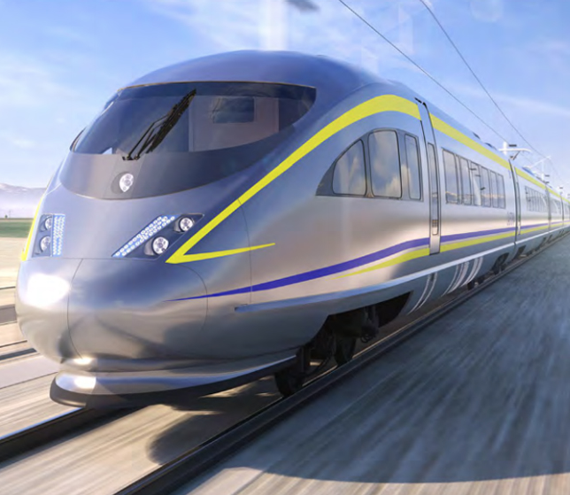
California High Speed Rail Project
Very Large and Very Complex Project:
From San Francisco to LA to San Diego
First electrified high-speed rail project in the United States
World Class Infrastructure
Currently in Progress

Slide 3
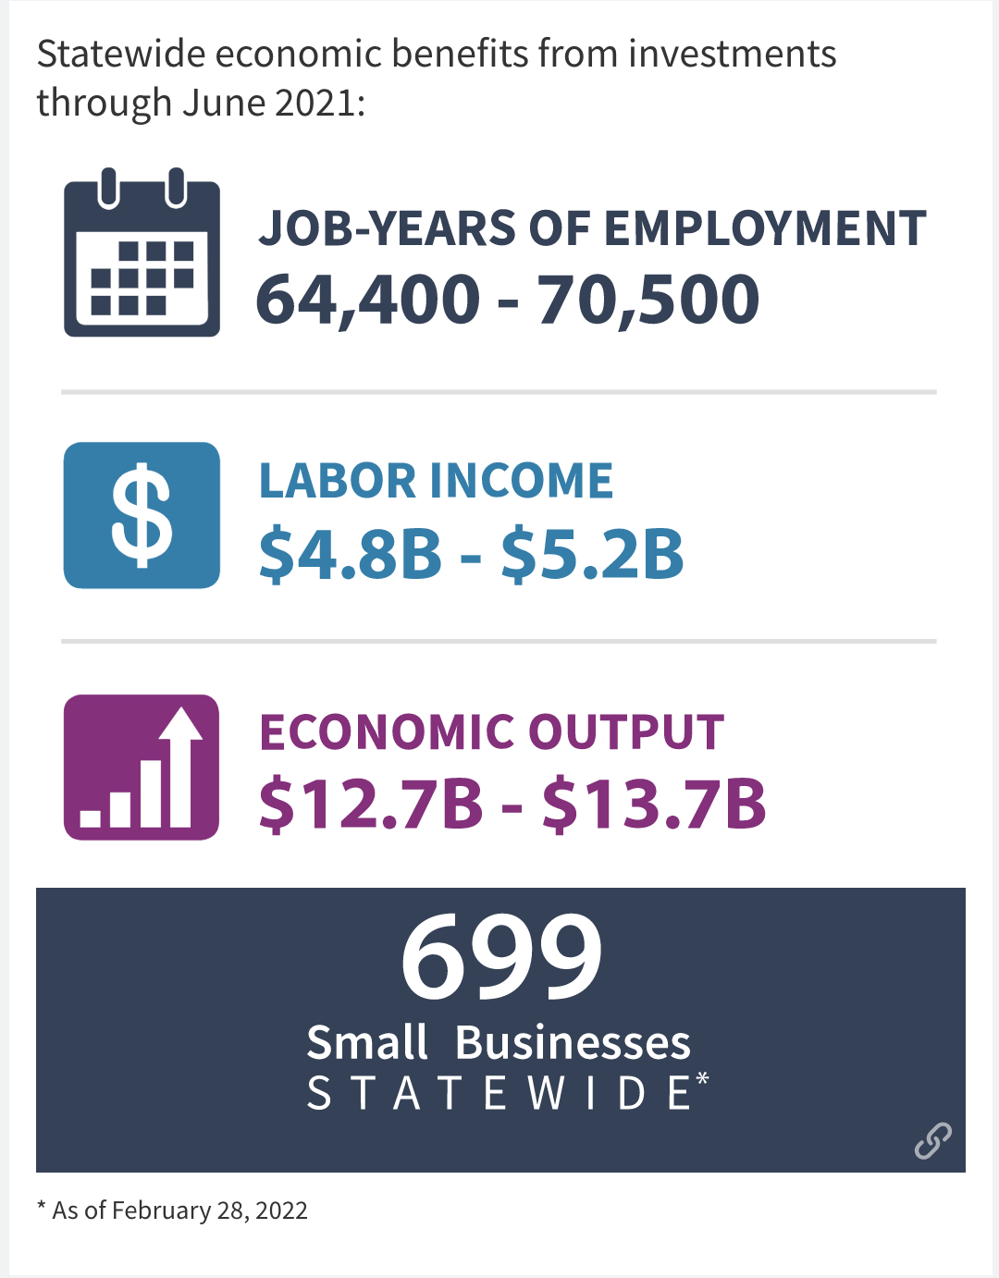

Why does it matter?
Take millions of cars off the road
Saving millions of barrels of oil
Clean up the air
Notes:
Social benefits according to biden;
Take millions of cars of the street with more people using the trina
Save on oil for car usage
Clean up the air since its more ecofriendly
Econnic benefits
More jobs created
Labor income
Econmoists have shown higher economic output from building railways

Slide 4
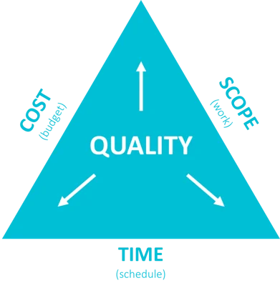
California High Speed Rail Project
Need to Monitor and Control :
Various Priorities: Mobility, Economy, Environment
Project progressing as fast as possible
Strategically Allocating resources and managing finances
Triple Constraints closely controlled

Slide 5
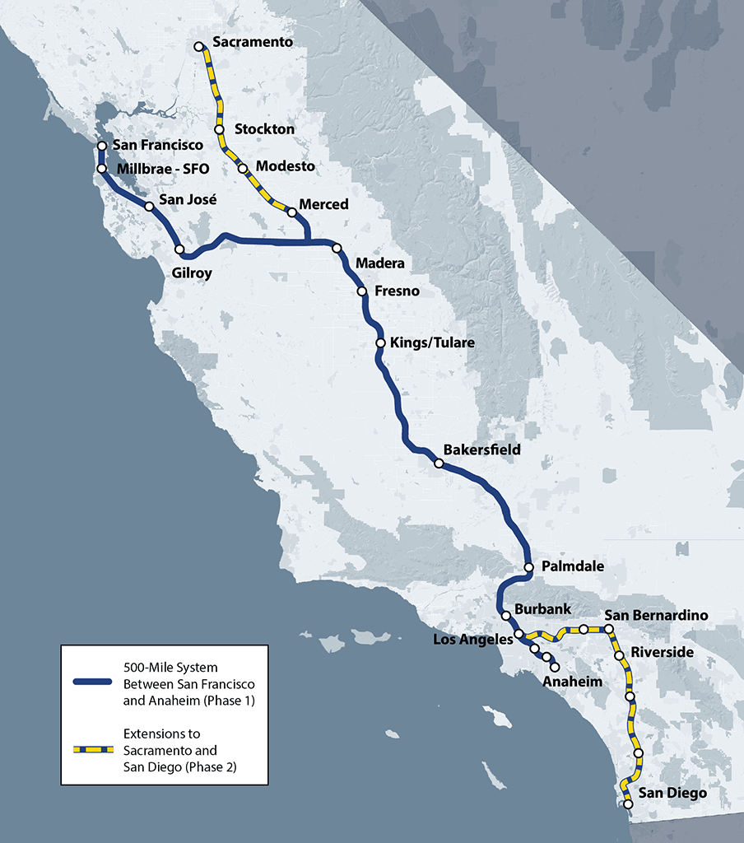
Progress Overview
Construction :
Completed Design
Resolved lots of scope changes
Daily construction 3x in the last year
Land acquisition:
Ahead of schedule
Issues with getting into construction contracts before acquiring the land
Issues with permits and 3rd party concerns
Changed leadership to attempt to fast track
Environmental review:
Clearled 420 miles so far
500 miles in total to be cleared

Slide 6
Schedule Control

Slide 7
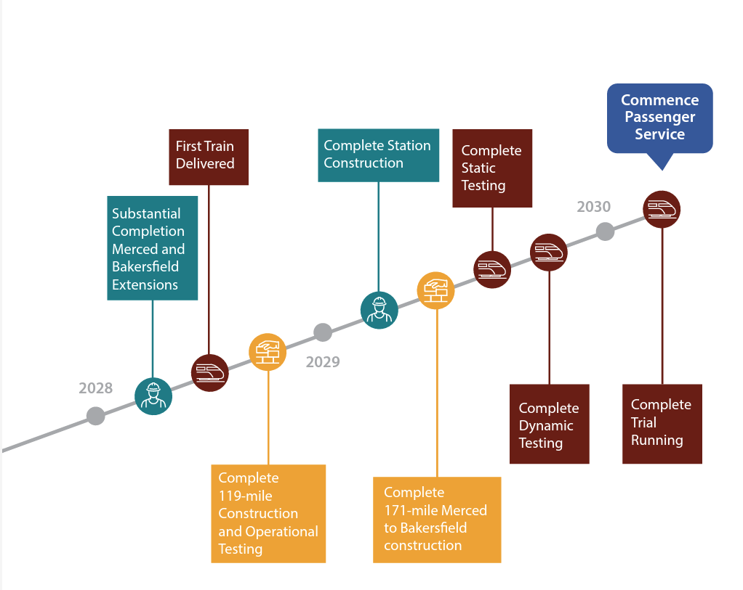
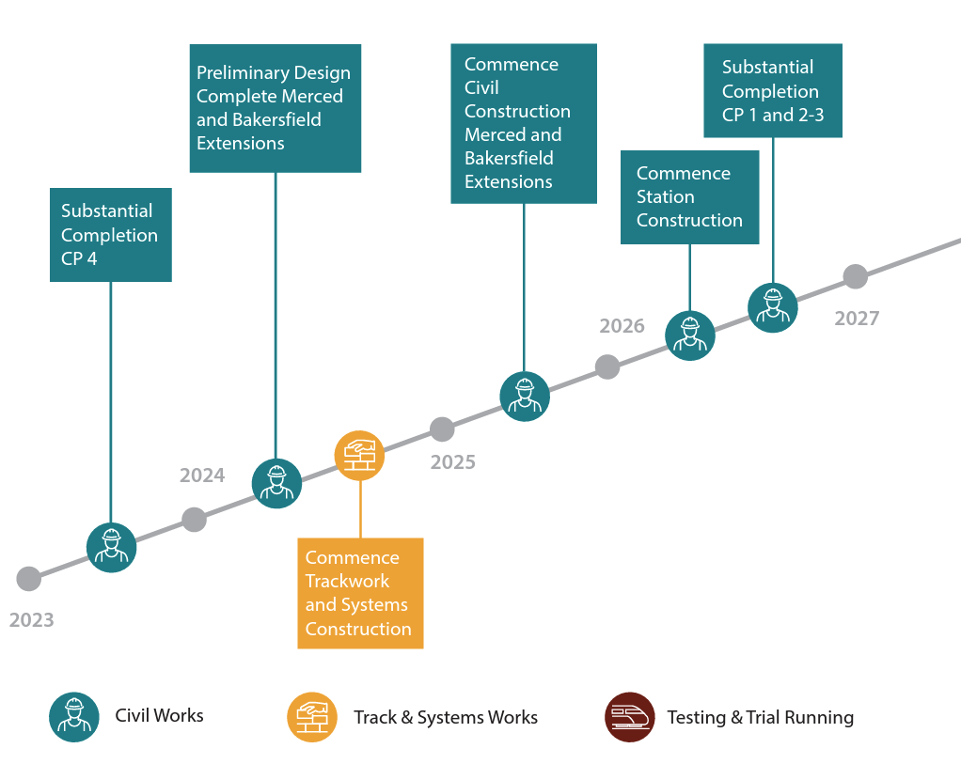
The planned project schedule for the decade
Notes:
Schedule control in PMI refers to the art of effectively managing the project to ensure it stays on track, so here is the planned schedule for construction packages 1, 2-3, and 4. Here it includes civil work, track and systems work, and testing and trial running phases. Testing and trial running is expected to start from 2028 and the whole project is expected to complete in 2030. We will go over each construction package in detail next.

Slide 8
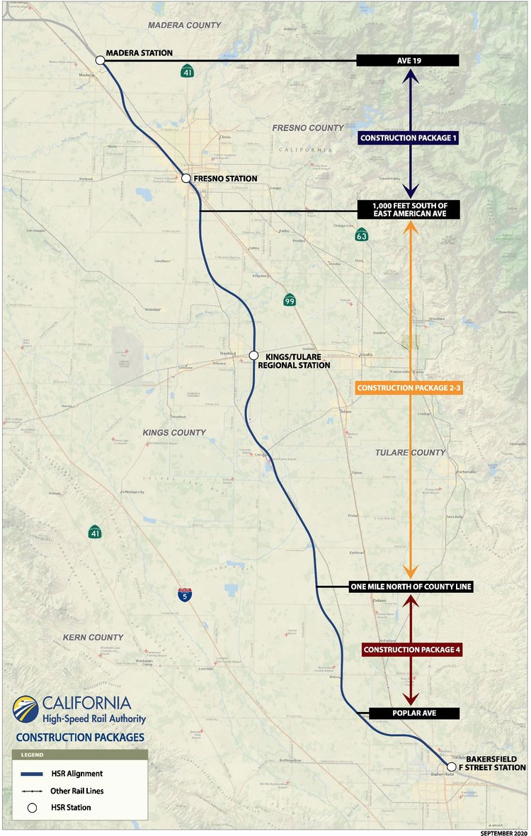
Construction
Package
Map
CP1
CP2-3
CP4
Notes:
Here is a construction package map and each arrow shows their regions.

Slide 9
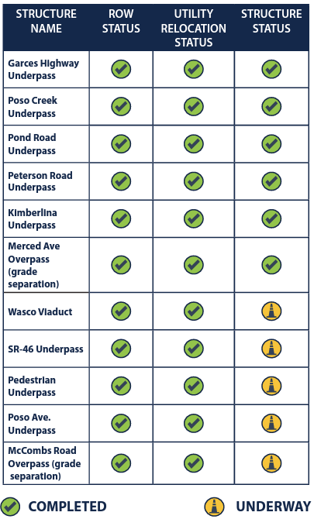
Overview of Project Schedule Control
Status of the construction packages and Heavy Maintenance Facility for CAHSR project
Construction Package 4
Length: 22 miles (35 km)
Location: Adjoining the end of CP2-3 to the
intersection of Poplar/Madera Avenue northwest of Shafter
Components: At-grade embankments, retained-fill
over-crossings, viaducts, aerial sections of the high-speed
rail alignment, and relocation of 4 miles (6.4 km) of existing
Burlington Northern Santa Fe (BNSF) tracks
Risks: Third-party agreements and weather conditions
Design-build contract signed: February 29, 2016
Forecasted completion: Summer 2023
Notes:
Construction package 4 is the first CP to be finished and is 22 miles long. It is expected to be completed by summer 2023. However, two primary risks that could impact the completion schedule, including the need for agreements and approvals from third parties, specifically water districts and bad weather conditions.

Slide 10
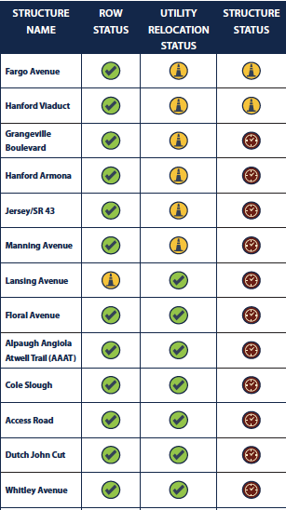


Overview of Project Schedule Control
Status of the construction packages and Heavy Maintenance Facility for CAHSR project
Construction Package 2-3
CP4
Length: 65 miles (105 km)
Location: East American Avenue south of Fresno to
1 mile (1.6 km) north of the Tulare/Kern County border
Components: 36 grade separations, viaducts,
underpasses, and overpasses
Risks: land rights, permits for road closures
Design-build contract signed: June 10, 2015
Forecasted completion: 2026
Notes:
Construction package 2-3 is expected to be finished on 2026 and is 65 miles long. The primary challenges for CP 2-3 includes acquiring land rights, obtaining design approvals, and securing permits for road closures.

Slide 11
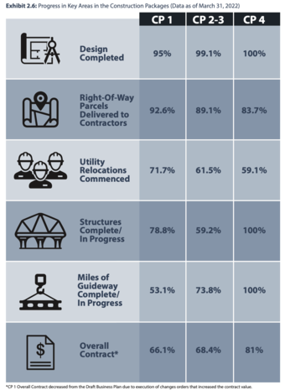
Overview of Project Schedule Control
Status of the construction packages and Heavy Maintenance Facility for CAHSR project
Construction Package 1
Length: 32 miles (51 km)
Location: Avenue 17 north of Madera to
East American Avenue south of Fresno
Components: 12 grade separations, two viaducts,
one tunnel, a major river crossing over the
San Joaquin River, and realignment of State Route 99
Risks: approvals on receiving permits for road closures
Design-build contract signed: August 16, 2013
Forecasted completion: 2026
Notes:
Construction package 1 is expected to be finished on 2026 and is 32 miles long. The primary obstacle for CP 1 includes acquiring approvals on receiving permits for road closures.

Slide 12
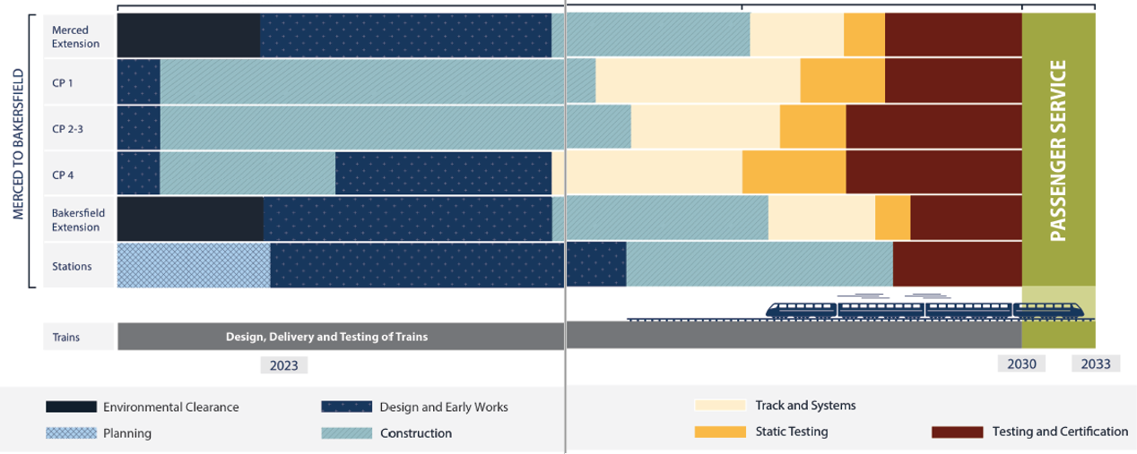
Schedule Control
The overall roadmap of Merced To Bakersfield station
Notes:
Here is the overall roadmap of Merced to Bakersfield station. It presents a comprehensive plan showcasing the integration of components and the necessary testing stages to achieve full operational capability.

Slide 13
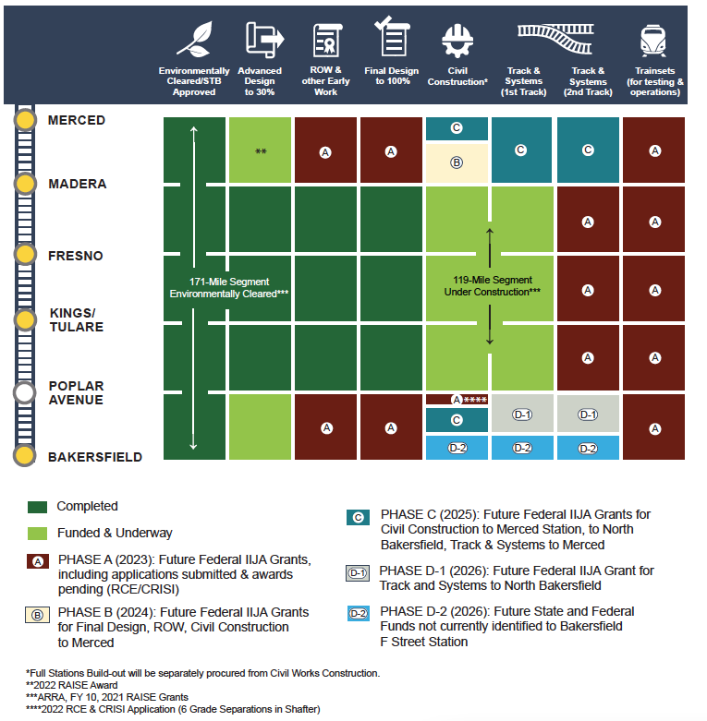
Phasing Approach- Critical path for 2030 passenger service goal
Critical Chain: the longest path in the network diagram considering activity interdependence and resource constraints
Critical Path: entire path through the diagram that will take the longest amount of time to complete
Notes:
In this diagram, the phasing plan strategically prioritizes the work for achieving the goal of passenger service by 2030, focusing on the critical path.
On the left side, represented by the dark green color, we can observe that the 171-mile segment, which is on the critical path, has received environmental clearance and has been completed. On the right side, the 119-mile segment, also part of the critical path, is currently being funded and is under construction.
The Critical Chain/Buffer Management (CC/BM) approach aims at the construction of latest start schedules where the project activities use aggressive time estimates and puts a clear focus on the determination of a realistic project deadline.

Slide 14
Cost Control

Slide 15
Overview of Project Cost Control
The purpose of cost control in PMI is to track variance in expenditures versus budgets.
In cost control, we usually focus on work authorization process and earned value management.

Slide 16
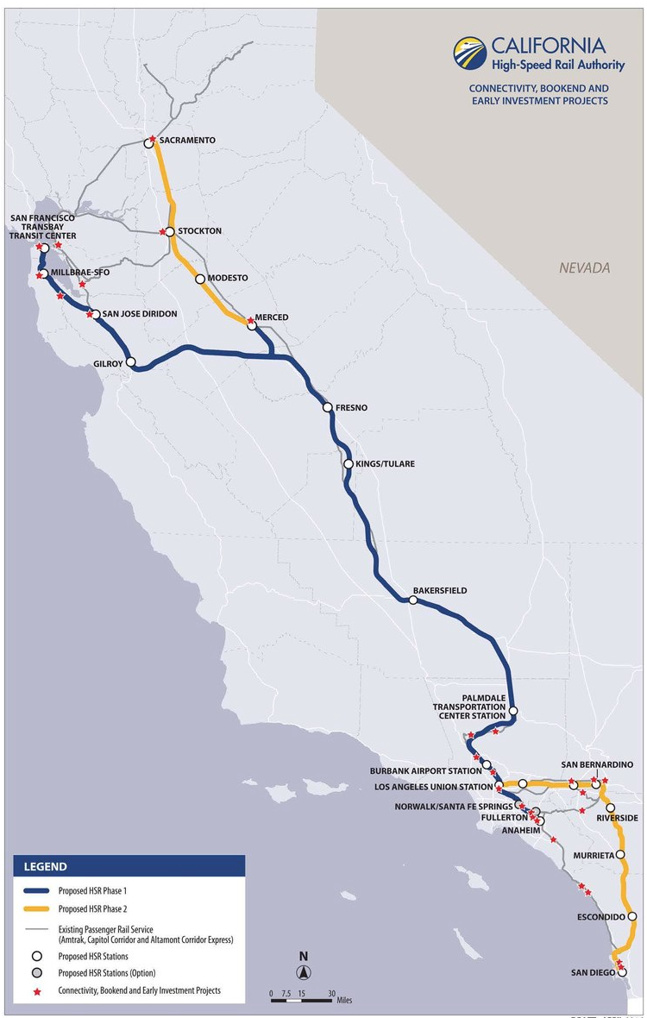
Work Authorization Process
A project is only started upon formal authorization and is only stopped upon review and acceptance.
On large projects, the authorization process of a phase of a project is subdivided into stages of contract release, project release, and work order release.
According to the 2022 HSR Business Plan, all segments in phase 1 is expected to be authorized by the California High Speed Rail Authority in 2024.

Slide 17
Earned Value Management
A PMI way to monitor the progress of a project:
Planned Value PV (budgeted cost of the work scheduled)- the sum cost of all work in the original budget.
Actual Cost AC (actual cost of the work performed)- the actual expenditure as of a given time period.
Earned Value EV (budgeted cost of the work performed) - the value of the work performed so far.

Slide 18
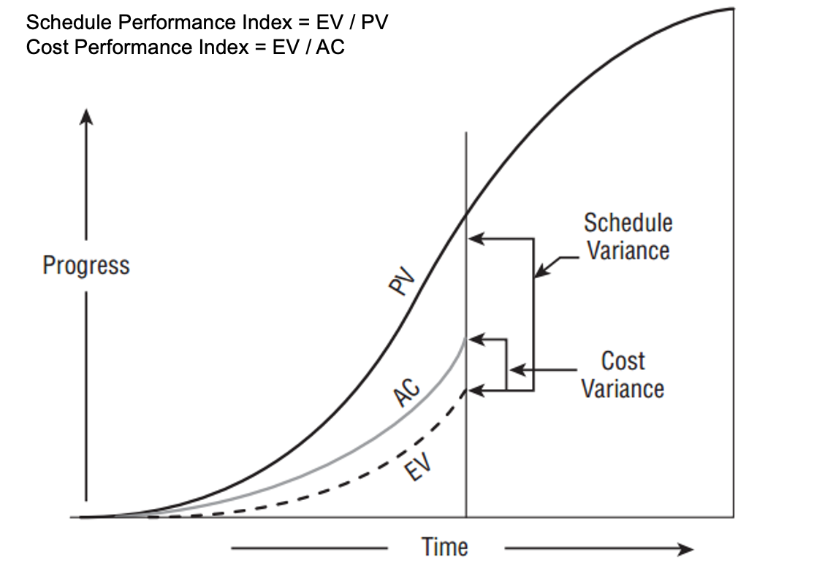
Earned Value Management (cont)
Scheduled Variance: SV = EV - PV
Cost Variance: CV = EV - AC
Positive SPI and CPI = project is on time and under budget.
Negative SPI and CPI = project is overdue and over budget.

Slide 19
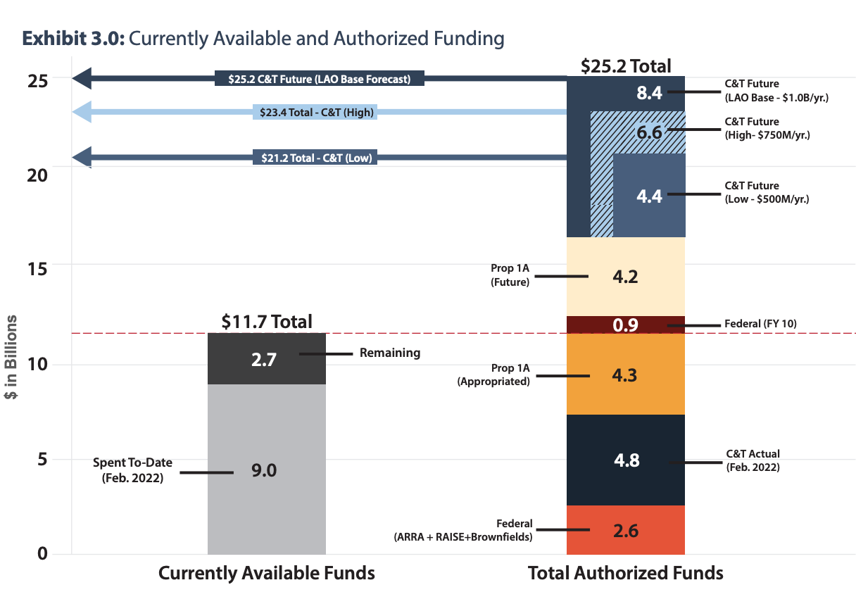
CAHSR Budget/Funding
PV
EV
Notes:
From the figure in 2022 CAHSR Business Plan, one can see that the total authorized fund for the CAHSR project is 25.2 billion so far. Using what we learned previously, this is the PV of the entire project. The spending-to-date at Feb 2022 is 9 billion. This is what we called EV.

Slide 20
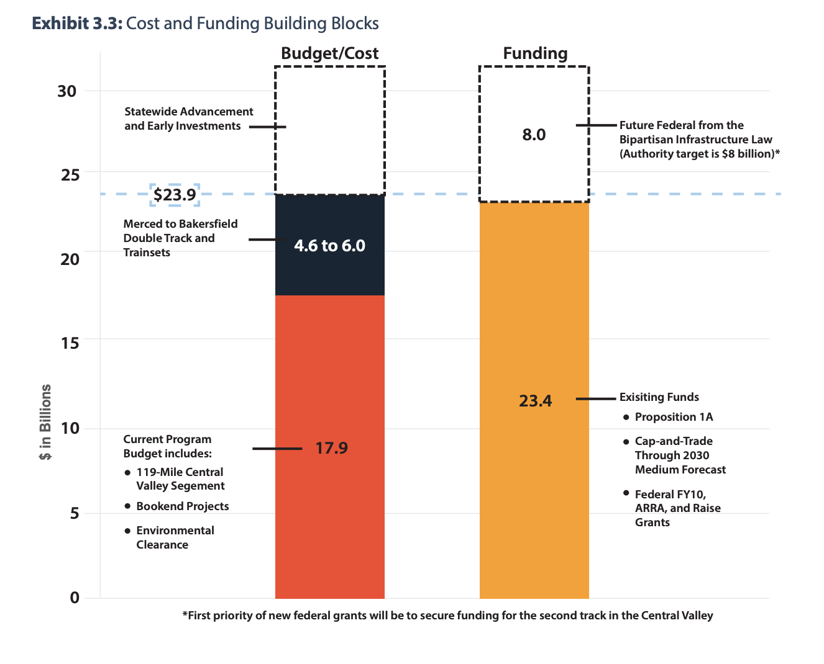
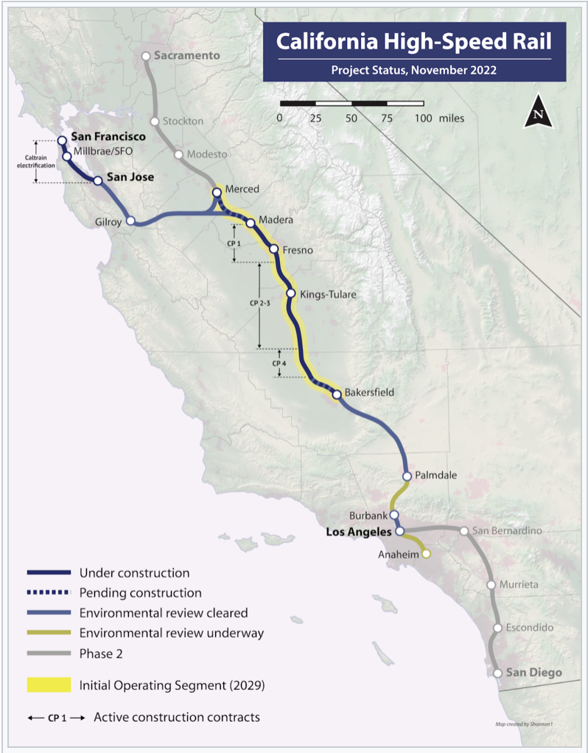
CAHSR Budget/Funding (cont)
Notes:
From another Figure in the 2022 CAHSR Business Plan, we find out that the current funding are used to build the initial operational segment from Merced to Bakersfield

Slide 21
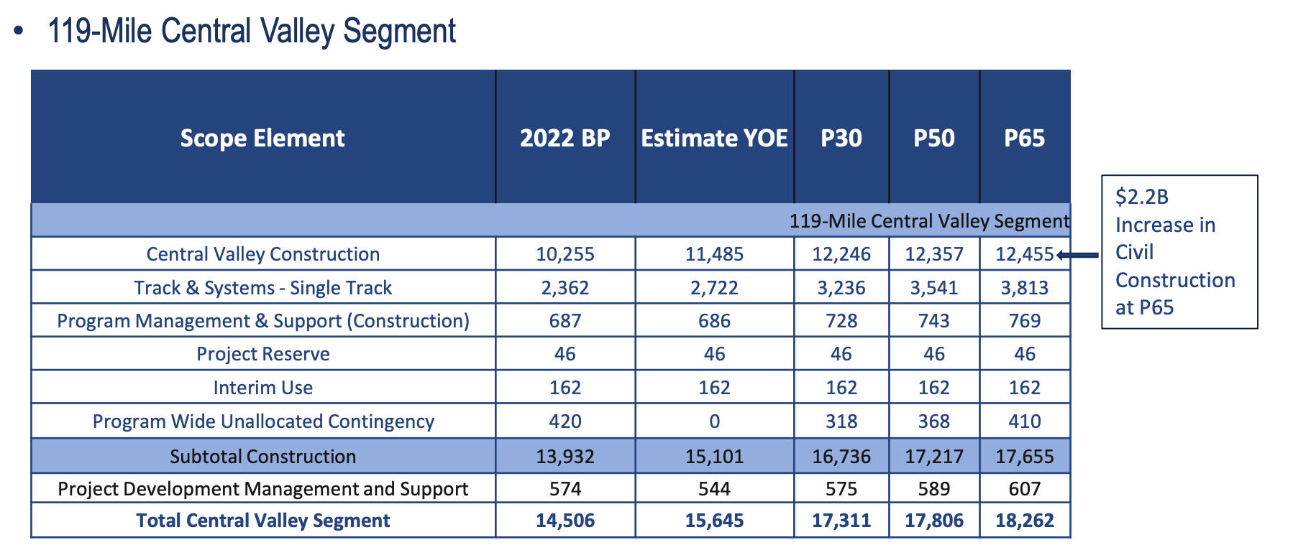
2023 Update to Funding
According to the 2023 Update Report, the project is facing inflationary pressures.
The total cost of the initial operating segment (Merced to Bakersfield) is now 2.2 billion more than previously estimated.
“The earlier we build it, the cheaper it will be!”

Slide 22
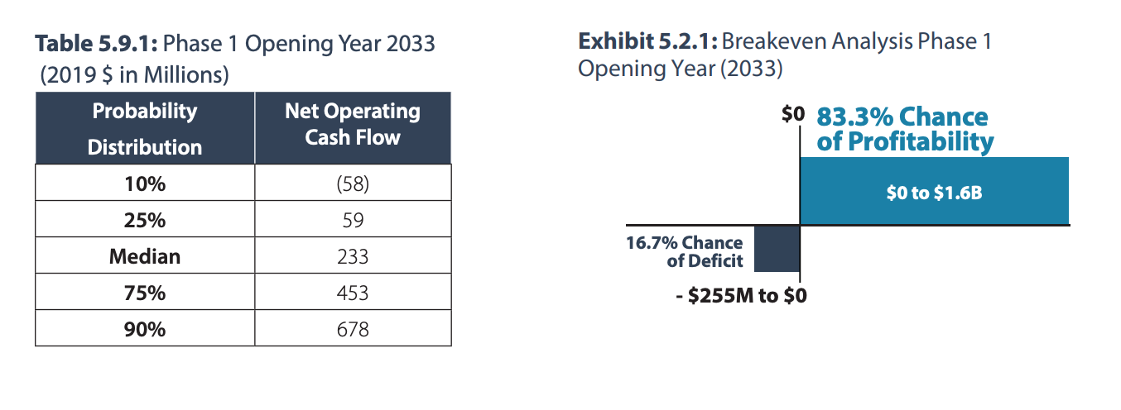
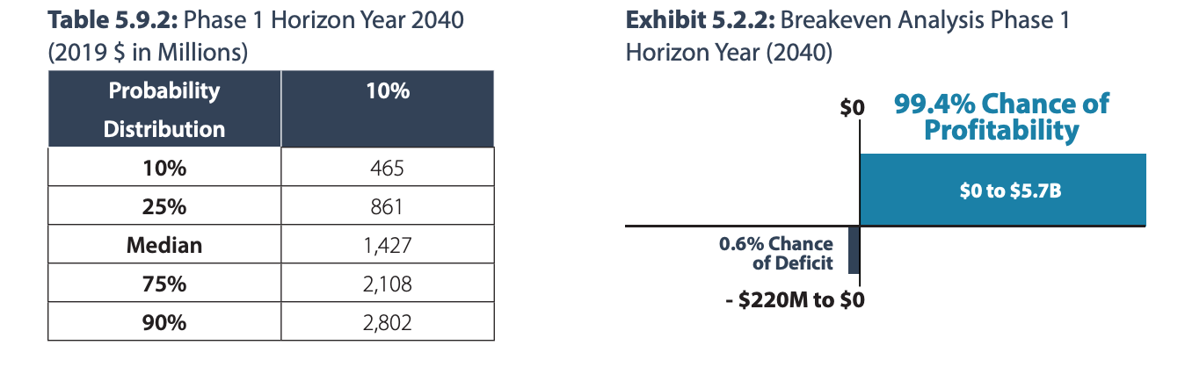
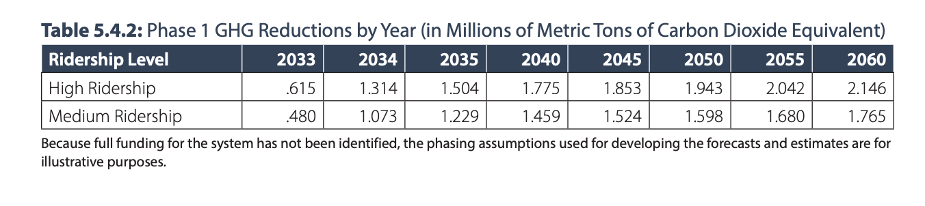
Forecasts and Estimates
Notes:
From the two charts above, one can see that the CAHSR project is very likely to be profitable with 83.3% in the opening year and 99.4% in 2040. From the table at the bottom, one can see that the completion of the CAHSS can significantly reduce cars on the road by cutting down tons of CO2 equivalent starting at the opening year.

Slide 23
Change Control and Scope Control

Slide 24
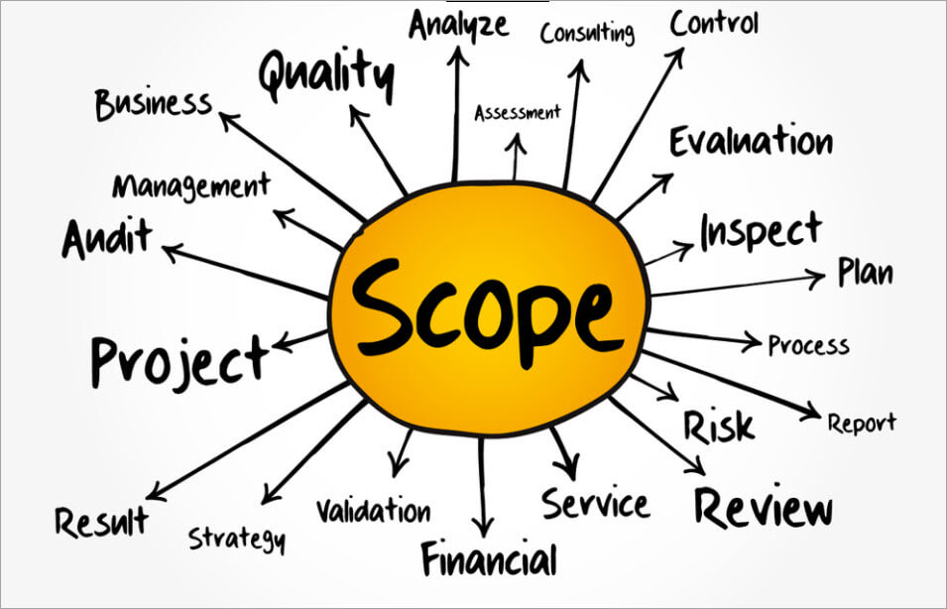
Scope Control
Implements phased implementation for scope control.
First phase: Interim Initial Operating Segment (Interim IOS).
Under construction in the San Joaquin Valley.
Runs from Merced to Bakersfield.
Planned operations to begin in 2030 or slightly later.
Upgrades commuter rail systems in San Francisco Bay Area and Greater Los Angeles.
Second Phase (currently unnamed):
Extends north to Sacramento and south to San Diego.
Total system length of about 800 miles.
Limited to 24 stations as per Proposition 1A.
Notes:
The California High-Speed Rail (CAHSR) project has been planned in two major phases:
Phase 1: This phase connects San Francisco and the Bay Area through the San Joaquin Valley (the southern part of the Central Valley) to Anaheim in the Greater Los Angeles area, a distance of about 500 miles. At the start of operations of the Interim Initial Operating Segment (Interim IOS, Merced to Bakersfield) there will be 5 stations​​.
Phase 2: This phase extends the north end of the Central Valley section up to Sacramento, and extends the Los Angeles section in the south through the Inland Empire down to San Diego at the southern edge of the state, for a total system length of about 800 miles. The number of stations on the completed system was limited by Proposition 1A to 24. Not all station locations have been decided yet​2.

Slide 25
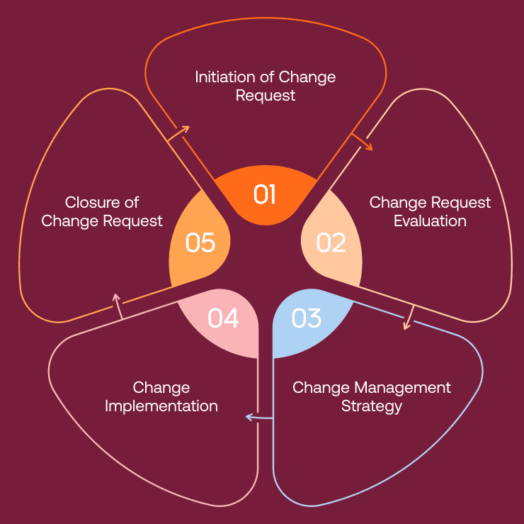
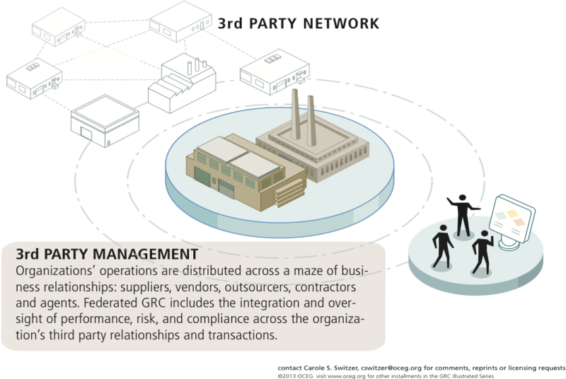
Change Control Systems
Change Control Committee (CCC): Established in September 2021 to manage change orders, set standards, and provide recommendations on major changes.
Third-Party Task Force: A dedicated team to address construction impacts from key stakeholders like Irrigation Districts, Railroads, Local Agencies, and Utility organizations.
Notes:
A key innovation observed in the management of the CAHSR project was the establishment of the Change Control Committee, or CCC, in September 2021. This independent body took on the vital role of managing change orders, including their processing, decision-making, and documentation. The CCC also defined the standards for supporting documentation and committed to ensuring timely processing of changes. It's worth noting that any alterations with a value of $1 million or more fell under the purview of the CCC for recommendations, thereby adding a level of scrutiny to significant changes.
In addition, the CAHSR team took an interesting approach to stakeholder engagement through the creation of a Third-Party Task Force. This group was tasked with addressing construction impacts from key external stakeholders, including Irrigation Districts, Railroads, Local Agencies, and Utility organizations. The proactive focus on third-party interfaces via the Task Force showcased an effective strategy in enhancing issue identification and resolution. This approach not only streamlined operations but also showed the project's commitment to fostering positive relations with these essential external partners.

Slide 26
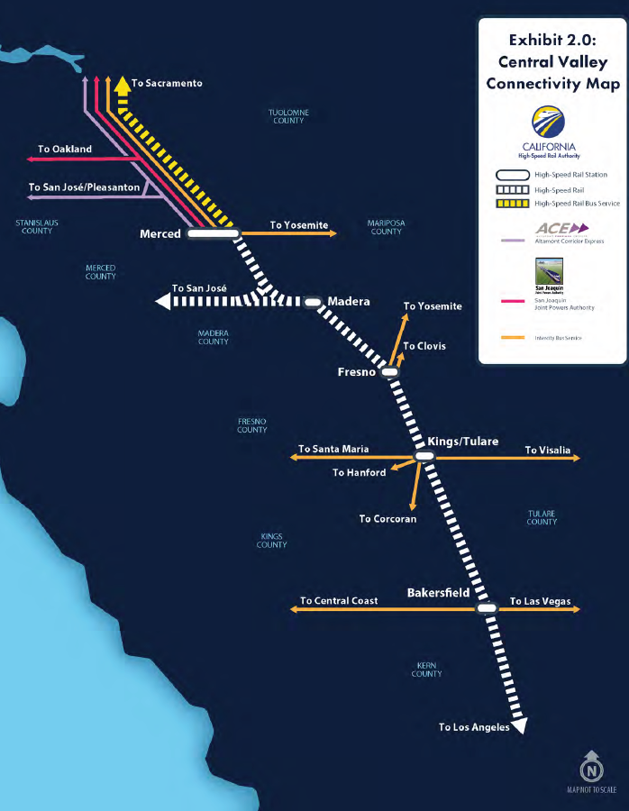
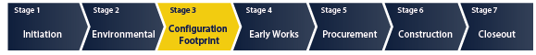
Configuration Management
Implemented a Staged Project Delivery process to manage the planning and environmental clearance process more effectively.
The process consists of seven stages: Project Initiation, Environmental, Configuration Footprint, Early Works, Procurement, Construction, Closeout.
Notes:
The High Speed Rail project in California has implemented a Staged Project Delivery process to manage the planning and environmental clearance process more effectively. The process consists of seven stages:
Stage 1 – Project Initiation
Stage 2 – Environmental
Stage 3 – Configuration Footprint
Stage 4 – Early Works
Stage 5 – Procurement
Stage 6 – Construction
Stage 7 – Closeout
Each project section overview includes an exhibit showing the current stage of development in that process. This process can be seen as a form of configuration management as it involves managing the different stages of the project and ensuring that all elements of a project or contract are coordinated in time.

Slide 27
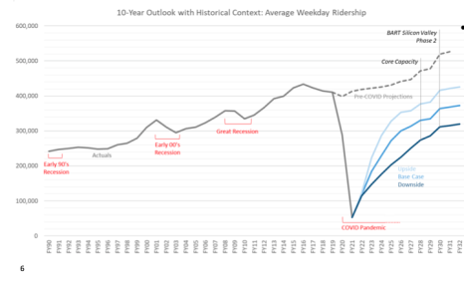
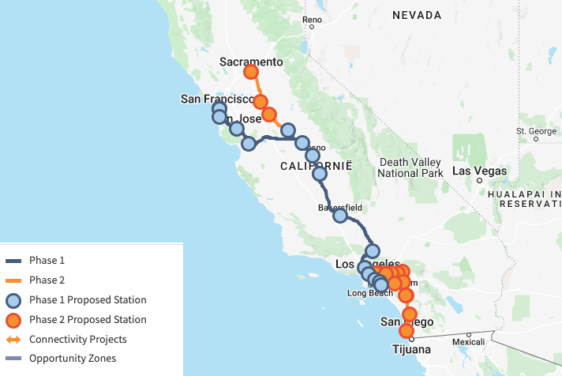
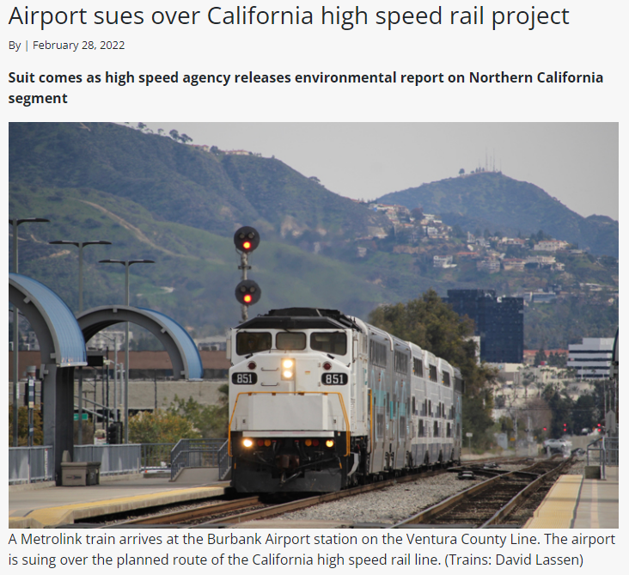
Reasons for Change in CAHSR
External Factors: Property acquisition, lawsuits, management experience, legislative oversight, and inflation affect the project progress.
Impact: These factors have led to cost escalations and delays.
Process Improvement: Phased segments allow for continual improvements.
Interim IOS: Scheduled for operation in 2030+ with a $100+ billion funding gap. Projected ridership down by 25% due to COVID-19 and declining population growth.
Political & Financial Challenges: Seeking $8 billion in federal grants amid a changing political landscape.
Notes:
The CAHSR project is facing significant external challenges including issues with property acquisition, legal matters, management proficiency, regulatory scrutiny, and inflation.
These challenges have resulted in increased project costs and delays in meeting important milestones.
The project's implementation in phased segments is a strategic approach to facilitate process improvements as it progresses.
The Interim Initial Operating Segment (Interim IOS) is planned to begin operations in 2030 or later, but it is facing a funding gap of over $100 billion due to increasing costs.
Projected ridership for the rail has decreased by 25% as a result of the COVID-19 pandemic and decreasing population growth in California.
The rail authority is currently seeking $8 billion in federal grants to help cover costs. However, the current political climate, including a Republican takeover of the House, has led to concerns about the continuity of support for the project.

Slide 28
Steps in Change Control in HSR
Identifying impacts:
Working to define project scope with community and stakeholder input.
Identifying potential impacts of changes on affected communities.
Investigating alternatives:
Continuously monitoring opportunities for private-sector investment.
Open to exploring alternative solutions before implementing changes.
Communicating:
Engaging in informed consultations with private-sector partners.
Issuing Requests for Expressions of Interest.
Commitment to ensuring stakeholders are informed about changes.
Notes:
Identify impacts: The Authority has been working to better define the project scope with community and stakeholder input. This involves identifying the potential impacts of changes on the communities affected by the project.
Investigate alternatives: The Authority is continuously monitoring opportunities for private-sector investment as the project advances and prerequisite activities are concluded. This suggests that they are open to investigating alternative solutions before implementing changes.
Communicate: The Authority has been engaging in more informed consultations with private-sector partners, including issuing future Requests for Expressions of Interest. This shows their commitment to ensuring all stakeholders are informed about the changes.

Slide 29
Steps in Change Control in HSR
Minimizing effects:
Authority committed to mitigations for impacted communities.
Efforts to minimize negative effects of changes.
Ensuring implementation:
Focus on delivering current project elements.
Proactively planning for the next step in the program.
Ensuring proper implementation and monitoring of changes.
Notes:
Minimize effects: The Authority has committed to certain mitigations that are important to the communities impacted by the project. This indicates their efforts to minimize the negative effects of changes.
Ensure implementation: The Authority is focusing on delivering the current elements of the project while looking to the next step in this program. This suggests that they are ensuring the changes are properly implemented and monitored.

Slide 30
Quality Control

Slide 31
Stages in Quality Control
Stage 1 Stage 2 Stage 3
Design & Build contracts
Final Design
Construction
Testing and Acceptance
Environmental Review and Preliminary Engineering
Final Integration, Testing and Certification

Slide 32
Stage 1
Identify project external requirements and analyze them for applicability
Develop project internal requirement docs that tailor the project external requirements
Apportion the project internal requirements to the specific procurement packages
Apportion the project internal requirements to the technical criteria
Identify critical requirements and interfaces between procurement packages
Review the Preliminary Engineering (PE) prepared by the regional team
Support the change process by providing change impact analysis capabilities

Slide 33
Stage 2
Contractor design and construction submittals including QA/QC and self-certification
Requirements verification traceability matrices (RVTM) demonstrating final design and construction is in compliance with technical contract requirements
Certifiable Items Lists (CIL) demonstrating final design and construction is in compliance with critical interfaces as identified and specified in contract requirements
Notes:
The stage 2, step 1 of the CHST V&V process (final design) uses the following documents as source documents, including: Scope of work General and special provisions Contractor Self-Certification and V&V process requirements Contractor applicable list of critical items Technical criteria

Slide 34
Stage 3
Civil | Trackwork | Systems | Rolling stock | Others
Integrated HSR system 1. Startup Testing 2. Revenue Testing
Operations and Maintenance
Revenue Operation
Notes:
https://www.hsr.ca.gov/wp-content/uploads/docs/programs/eir_memos/TM%201600.01%20VVMP%20R0%20130617%20no%20sigs.pdf

Slide 35
Risk Monitoring

Slide 36
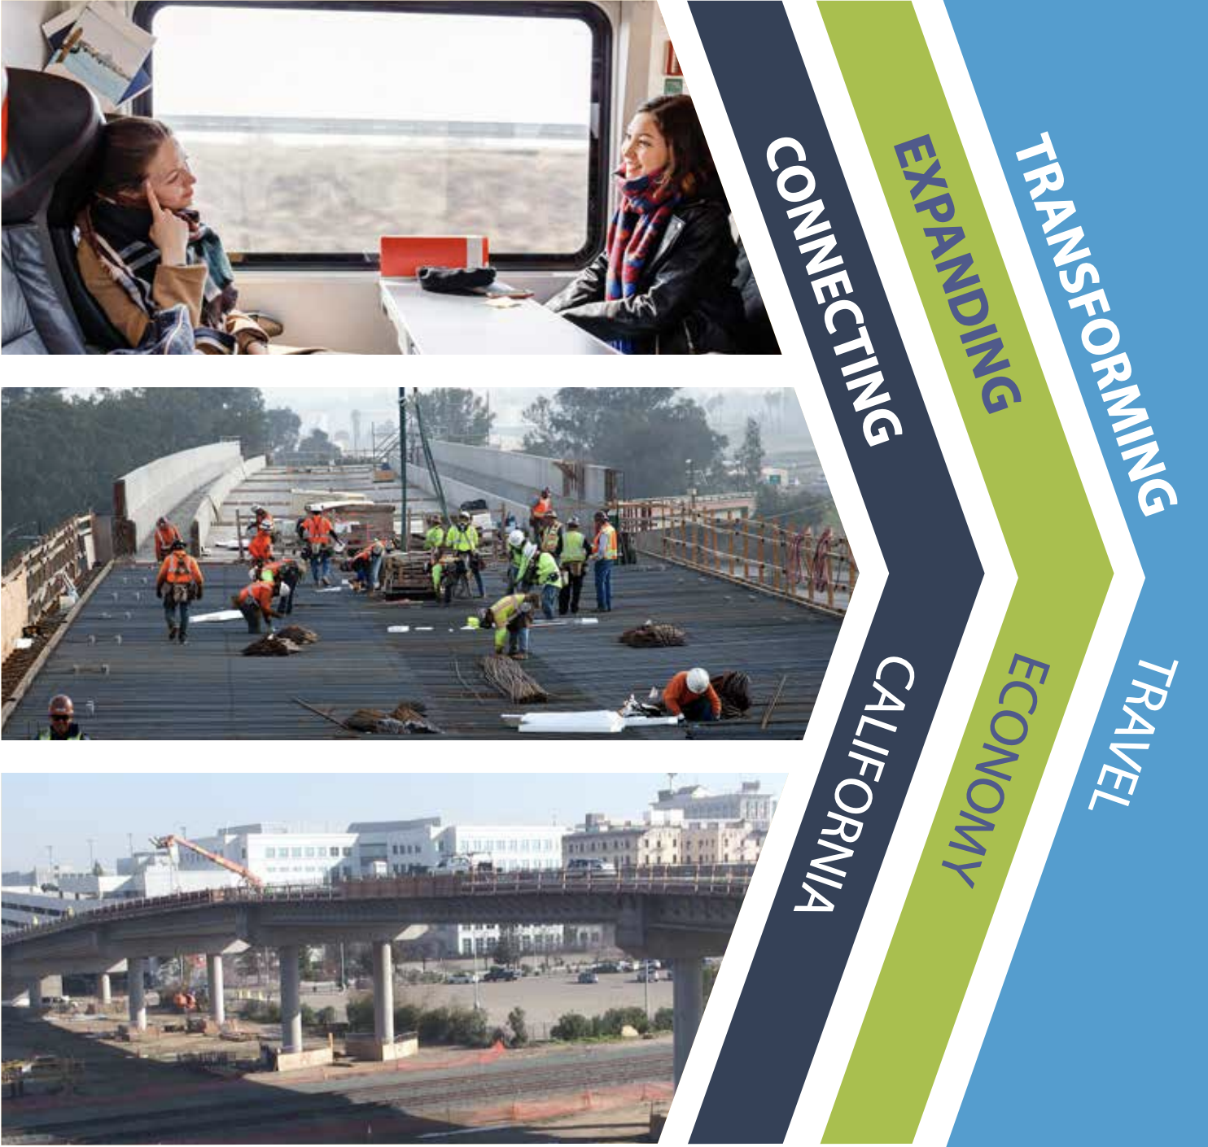
Risk Monitoring and Management
Program Level
Financing and funding
Legal and litigation
Construction
Right of way (ROW) acquisition delays
Environmental
Technology
Engineering and environmental

Slide 37
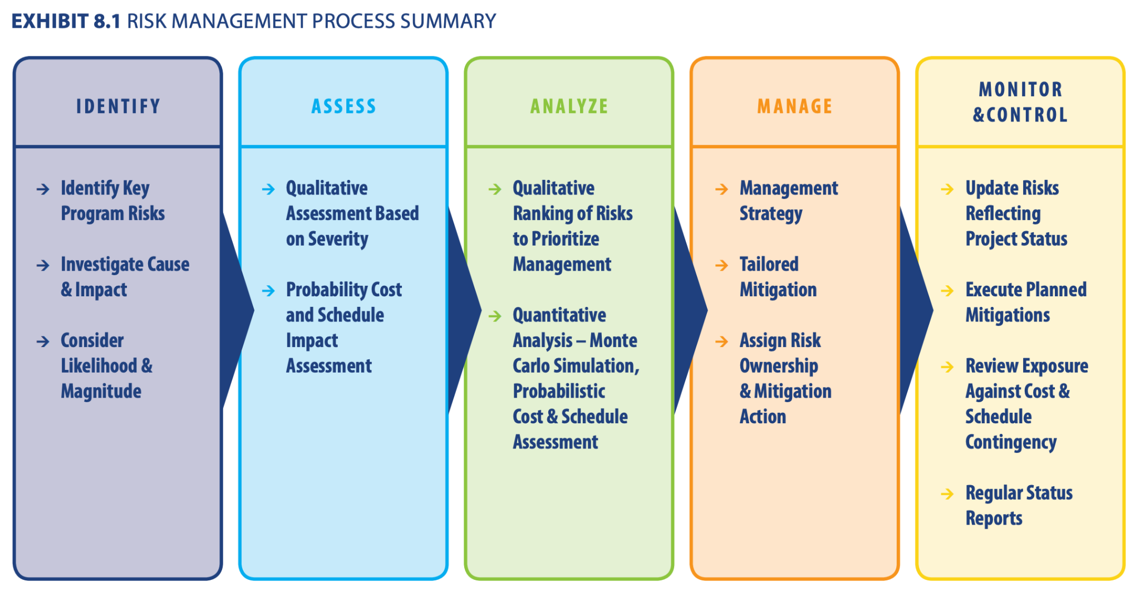
Risk Monitoring and Management

Slide 38

Risk Monitoring and Management
Principles
Risks are “owned”
Key risks must be documented and monitored
Organizational Structure
Regional risk managers, Director of risk management and project control, holistic enterprise risk management program
Risk Assessment Workshops
Assess identified risks, mitigation strategies, and management plans

Slide 39
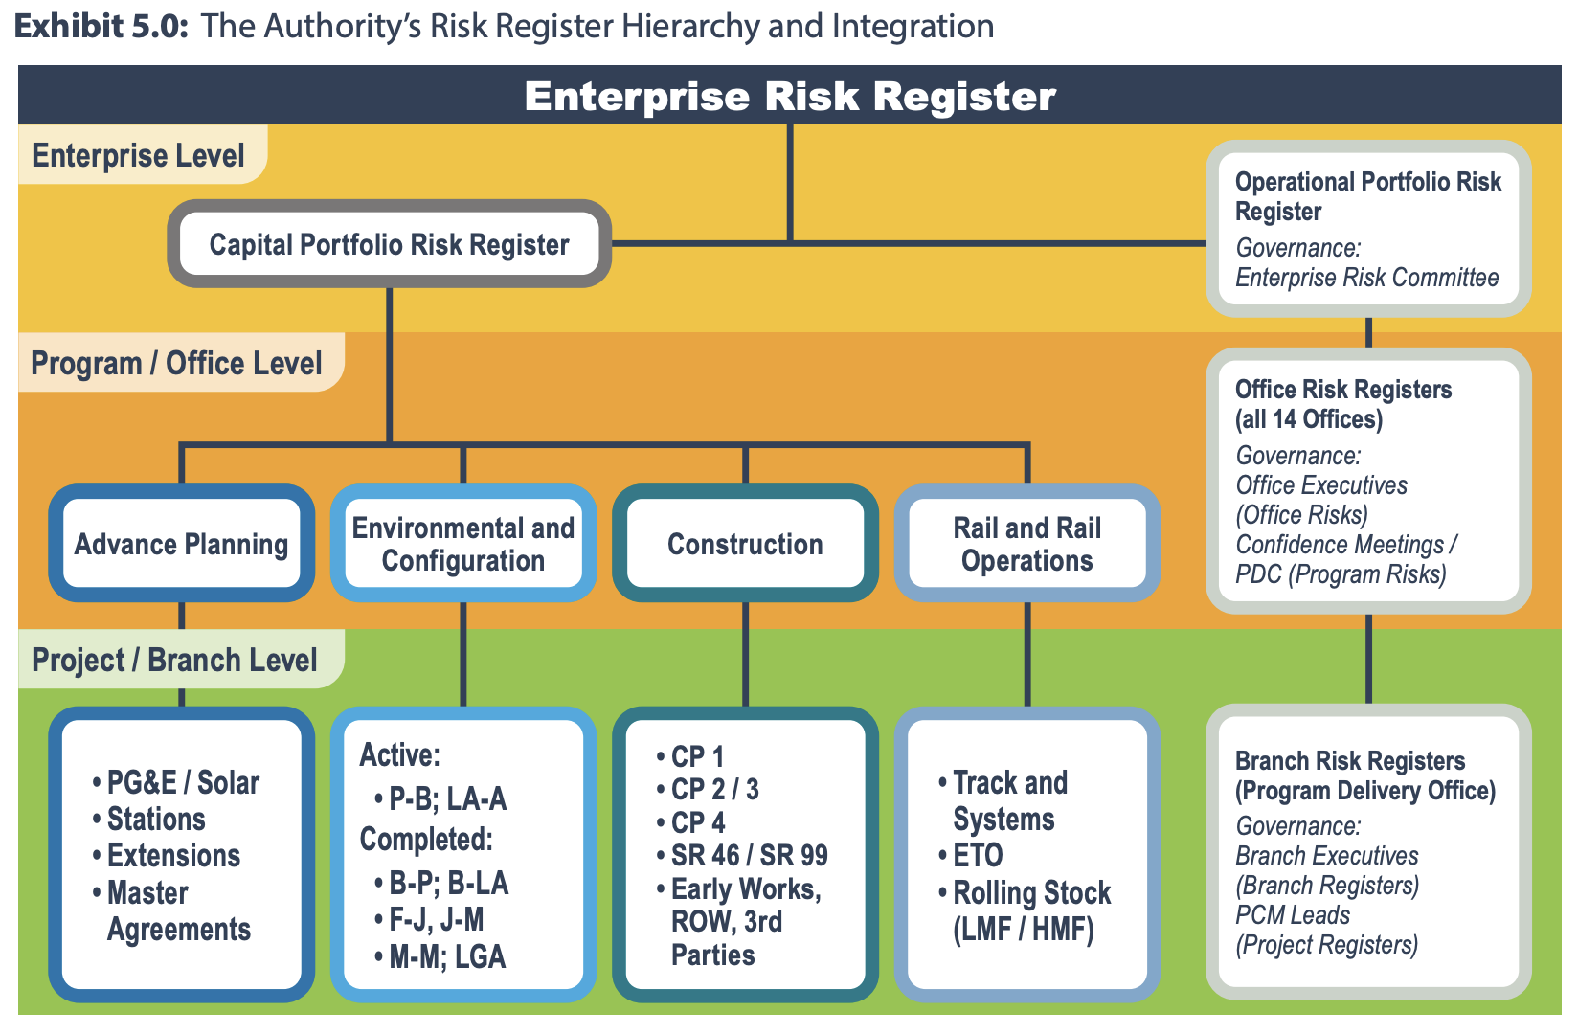
Risk Monitoring and Management
Risk Register - intermediate level of risk identification and monitoring in between project-level and enterprise-level.
Key issues and other risks that are being captured and monitored at the enterprise, project, and program level.
The Authority finalizes criteria that indicates when risks should be escalated or de-escalated, as needed.

Slide 40
Class Activity: Interactive Quiz
Notes:
Question needs to be entertaining or easy

Slide 41
Host Link for Quiz: https://create.kahoot.it/share/project-monitoring-quiz/a19cb12e-165e-4dca-a96f-11e2f94b2dd3

Slide 42
References
https://hsr.ca.gov/about/
https://hsr.ca.gov/about/high-speed-rail-business-plans/2022-business-plan/
https://hsr.ca.gov/wp-content/uploads/2022/05/2022-Business-Plan-FINAL-A11Y.pdf
https://www.hsr.ca.gov/wp-content/uploads/docs/programs/eir_memos/TM%201600.01%20VVMP%20R0%20130617%20no%20sigs.pdf
https://en.wikipedia.org/wiki/California_High-Speed_Rail
https://hsr.ca.gov/about/project-update-reports/2023-project-update-report/
https://hsr.ca.gov/wp-content/uploads/docs/about/business_plans/BPlan_2008_FullRpt.pdf
https://hsr.ca.gov/wp-content/uploads/docs/about/business_plans/BPlan_2012_rpt.pdf
https://hsr.ca.gov/about/high-speed-rail-business-plans/2014-business-plan/
https://hsr.ca.gov/wp-content/uploads/2021/04/2020_Business_Plan.pdf
https://hsr.ca.gov/wp-content/uploads/2022/05/2022-Business-Plan-FINAL-A11Y.pdf

